Slide 1
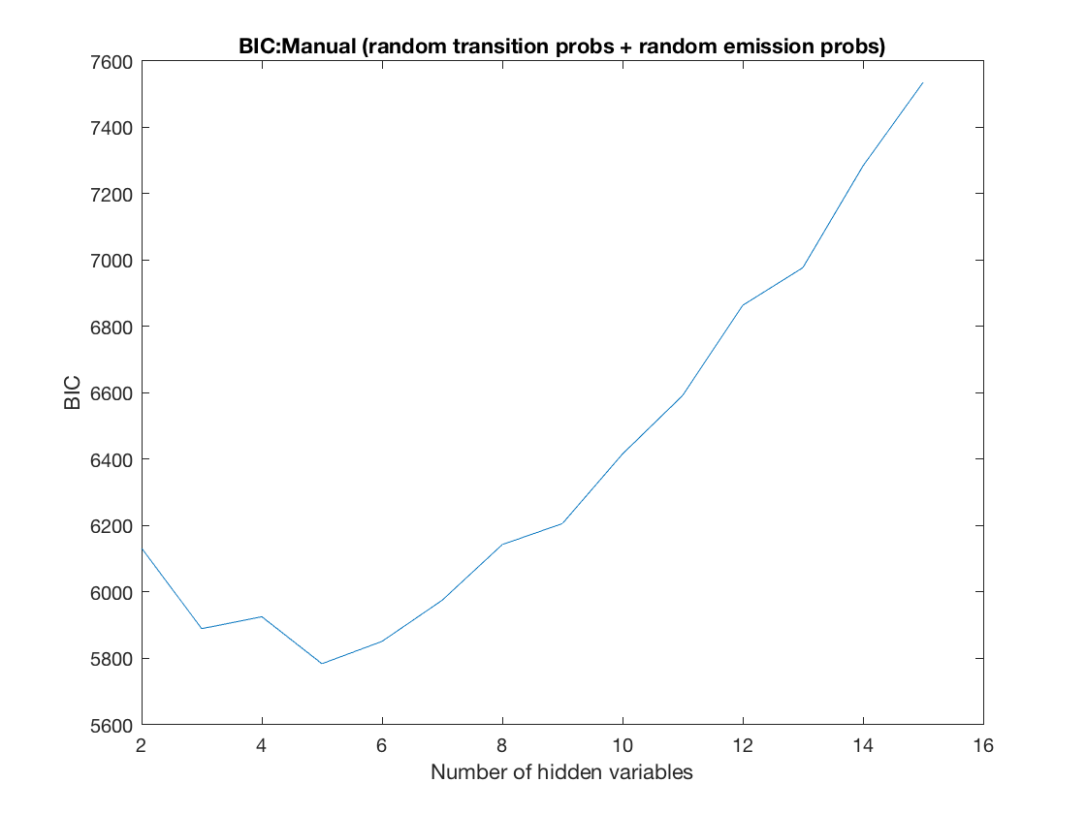
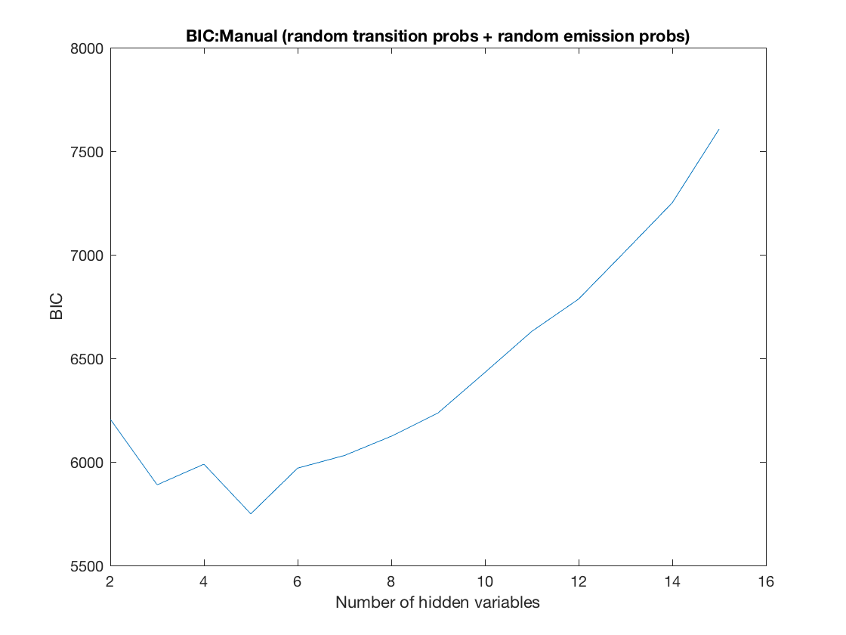
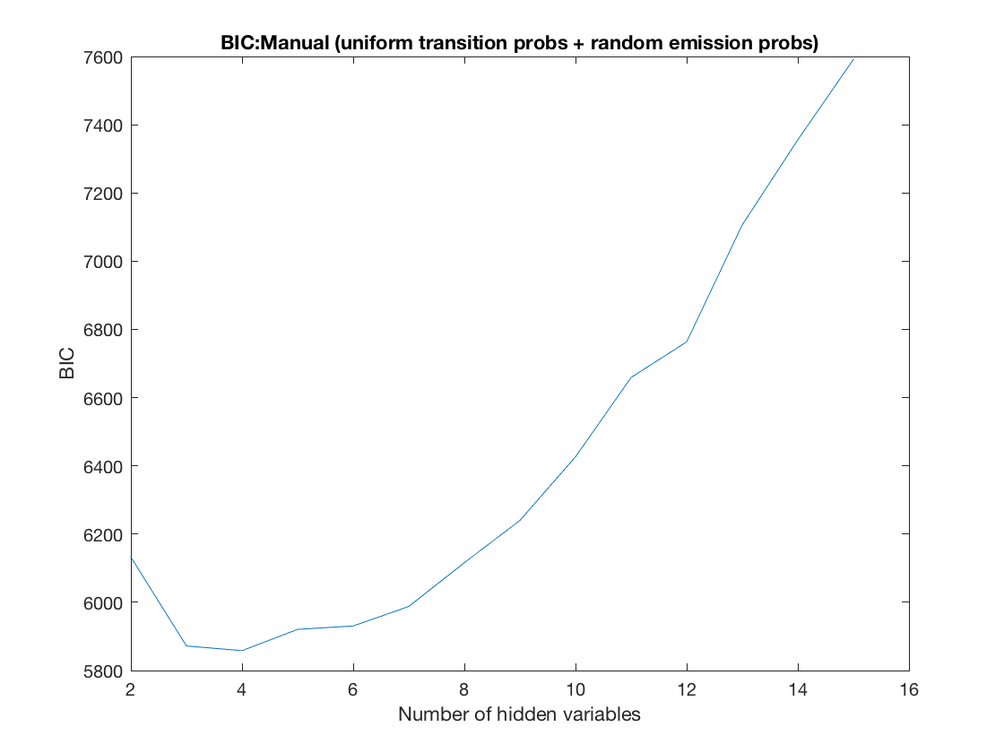

BIC Curves for Manual Mode

Slide 2


Manual Mode
index | Observations
1 | Takeoff
2 | Land Here
3 | View Switching
4 | Rise
5 | Descent
6 | Move Forward
7 | Move Backward
8 | Move Left
9 | Move Right
10 | Move Forward Left
11 | Move Forward Right
12 | Move Backward Left
13 | Move Backward Right
14 | Rotate Left
15 | Rotate Right
72.08%
#1
#2
21.40%
81.12%
16.14%
10.31%
22.75%
27.18%
#5
44.96%
#3
Move forward
87.34%
7.25%
5.17%
6.67%
#4
5.01%
81.08%

Slide 3
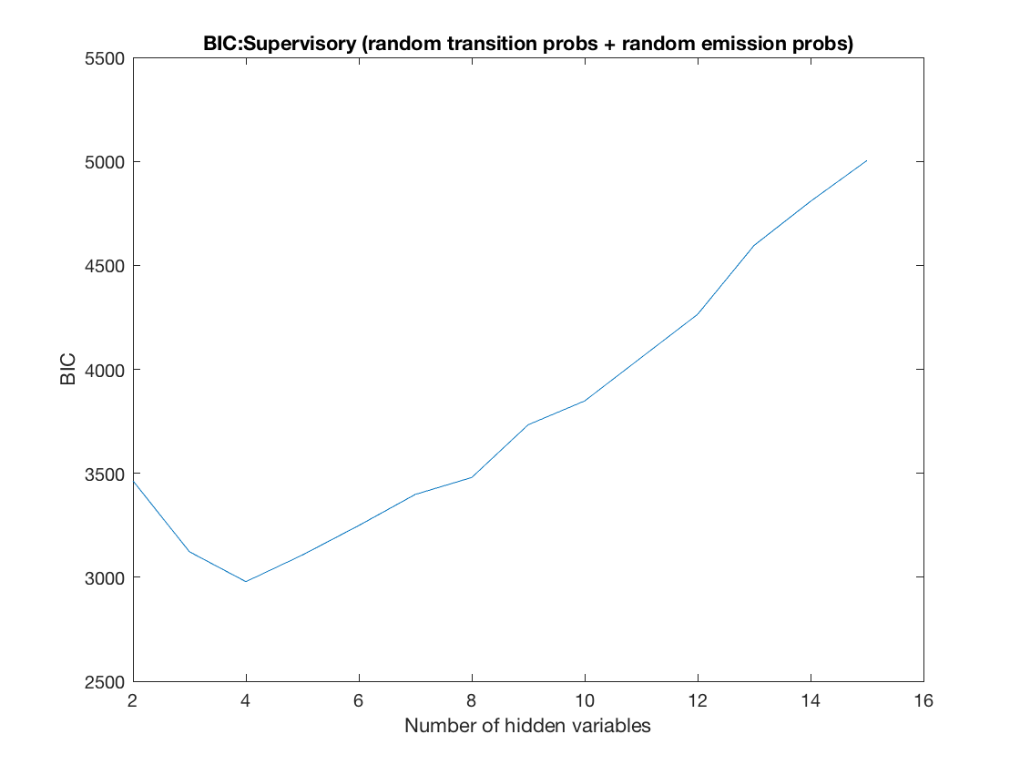
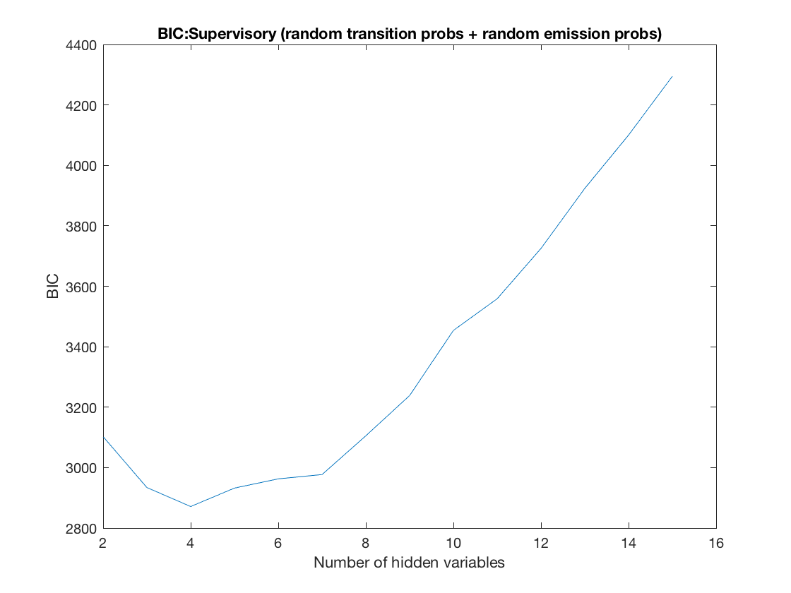
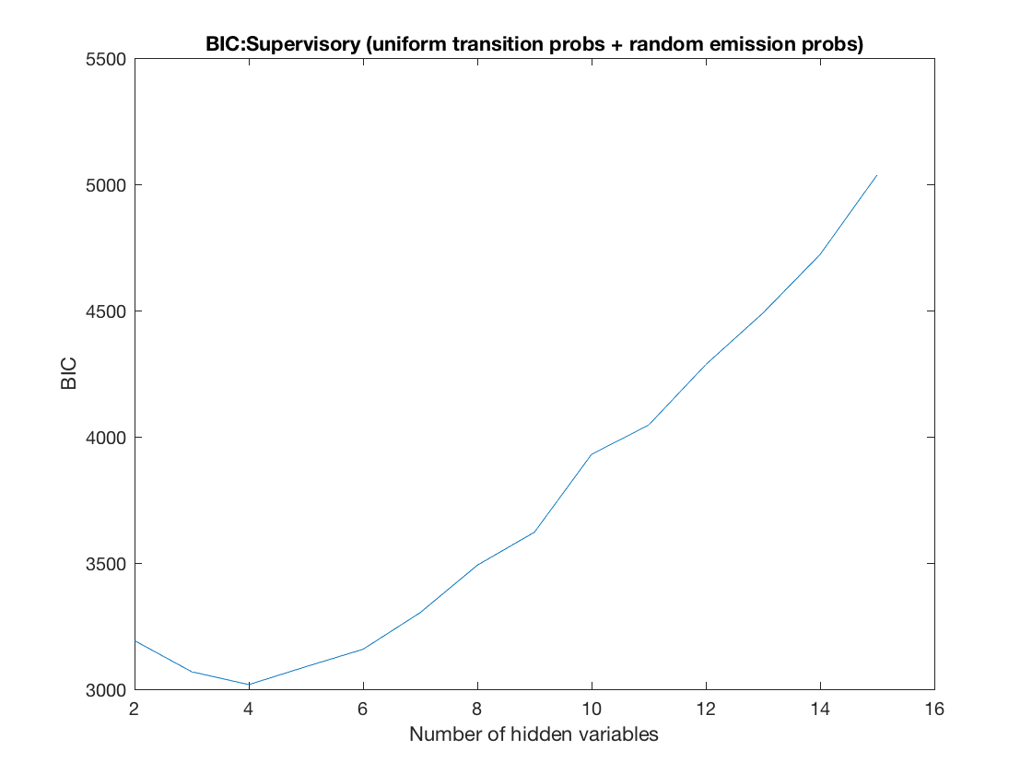
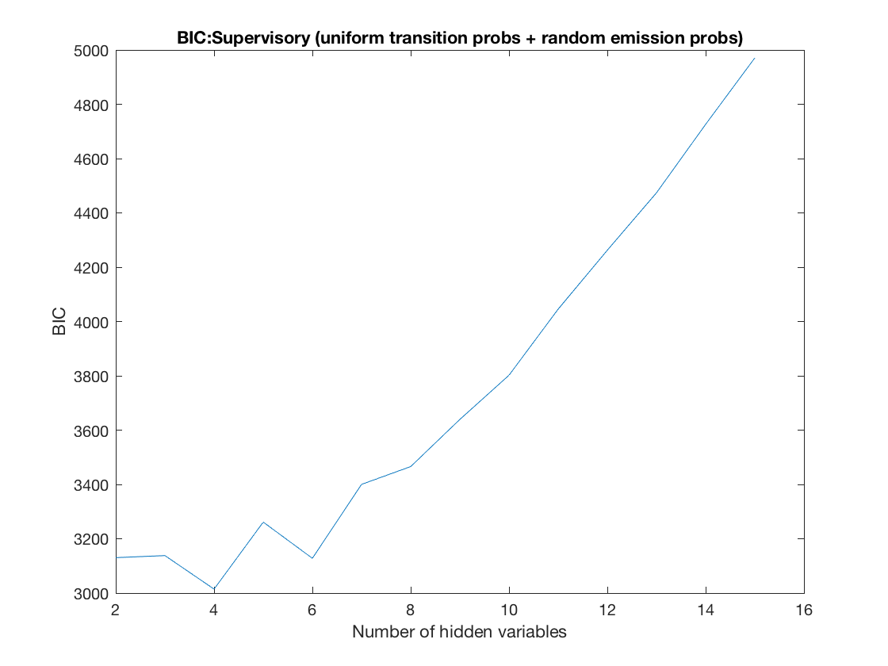
BIC Curves for Supervisory Mode

Slide 4
Supervisory Mode
index | Observations
1 | Takeoff
2 | Land Here
3 | Execute Flight plan
4 | Add Waypoint
5 | Adjust Waypoint
6 | Launch Inspection Mode
7 | Return to Supervisory Control
8 | Rise
9 | Descent
10 | Move Forward
11 | Move Backward
12 | Move Left
13 | Move Right
14 | Rotate Left
15 | Rotate Right
#1(164)
Manage Flightplan
#2(50) Return
Supervisory
44.68%
81.25%
18.75%
55.32%
19.61%
10.81%
#4(394)
Manual Control
#3(59)
Launch Inspection
89.82%
80.39%
Log_Lik = -1.2423e+03

Slide 5
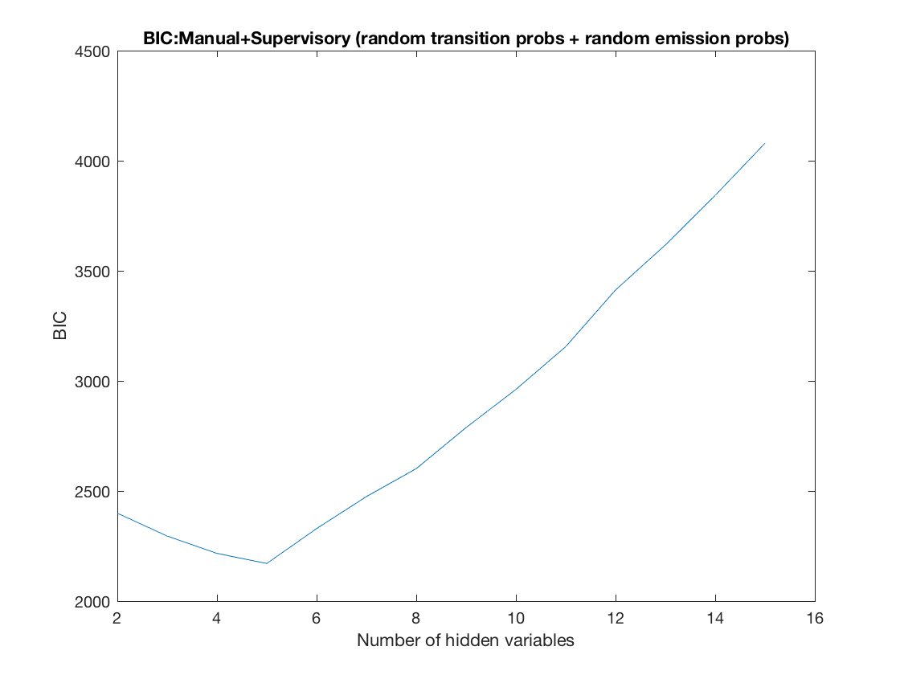
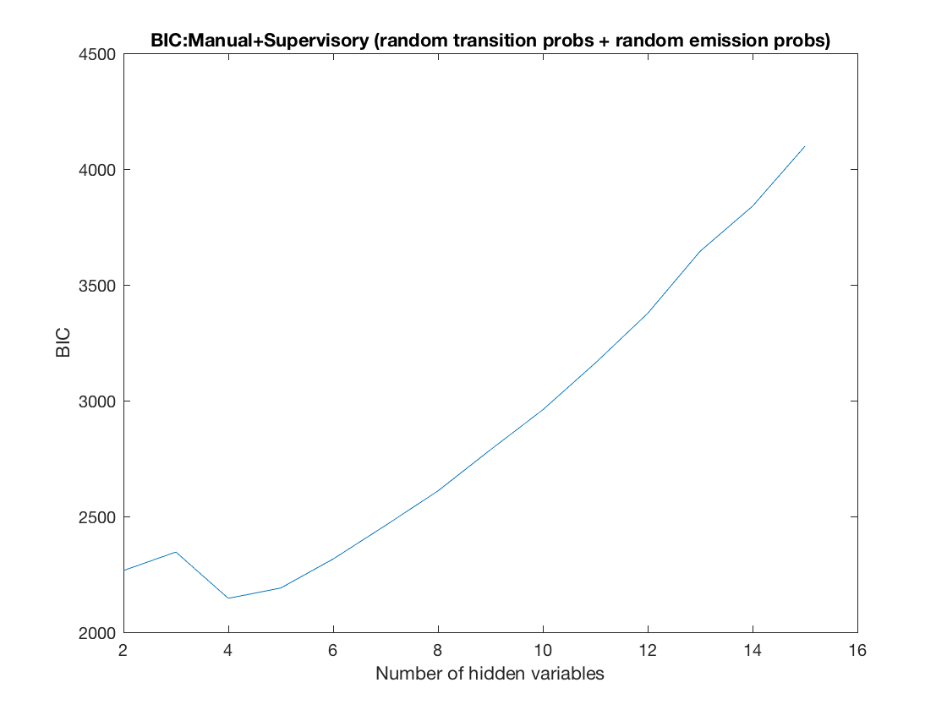

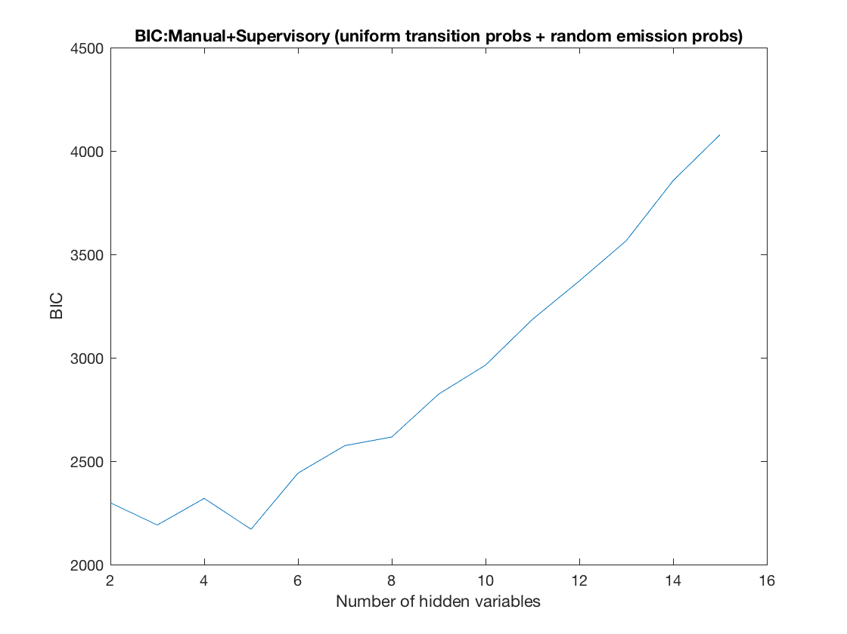
BIC Curves for Manual+Supervisory Mode

Slide 6
Manual + Supervisory Mode (4 Hidden States)
index | Observations
1 | Takeoff
2 | Land Here
3 | Execute Flight plan
4 | Add Waypoint
5 | Adjust Waypoint
6 | Launch Inspection Mode
7 | Return to Supervisory Control
8 | Rise
9 | Descent
10 | Move Forward
11 | Move Backward
12 | Move Left
13 | Move Right
14 | Rotate Left
15 | Rotate Right
#1(131)
Manage Flightplan
#2(62)
Return
Supervisory
63.33%
68,89%
31.11%
17.87%
36.67%
39.68%
#4(208)
Manual Control
#3(64)
Launch Inspection
82.13%
60.32%
Log_Lik = -838.1732

Slide 7
Manual + Supervisory Mode (5 Hidden States)
index | Observations
1 | Takeoff
2 | Land Here
3 | Execute Flight plan
4 | Add Waypoint
5 | Adjust Waypoint
6 | Launch Inspection Mode
7 | Return to Supervisory Control
8 | Rise
9 | Descent
10 | Move Forward
11 | Move Backward
12 | Move Left
13 | Move Right
14 | Rotate Left
15 | Rotate Right
50.94%
#1(85)
Manipulate Waypoint
#2(66)
Launch Inspection
1.60%
60.32%
47.46%
39.68%
82.01%
38.14%
57.61%
#5(207)
Manual Control
#3(62)
Return Supervisory
17.99%
6.41%
93.59%
4.25%
#4(45)
Initiate
Log_Lik = -778.2678

Slide 8
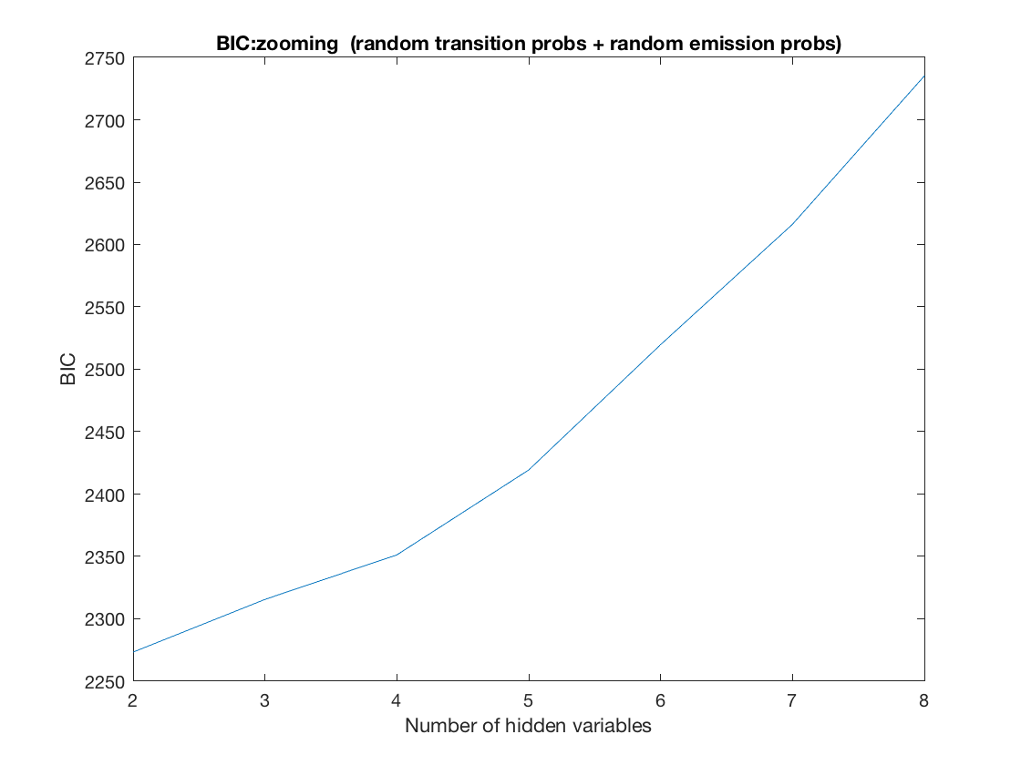
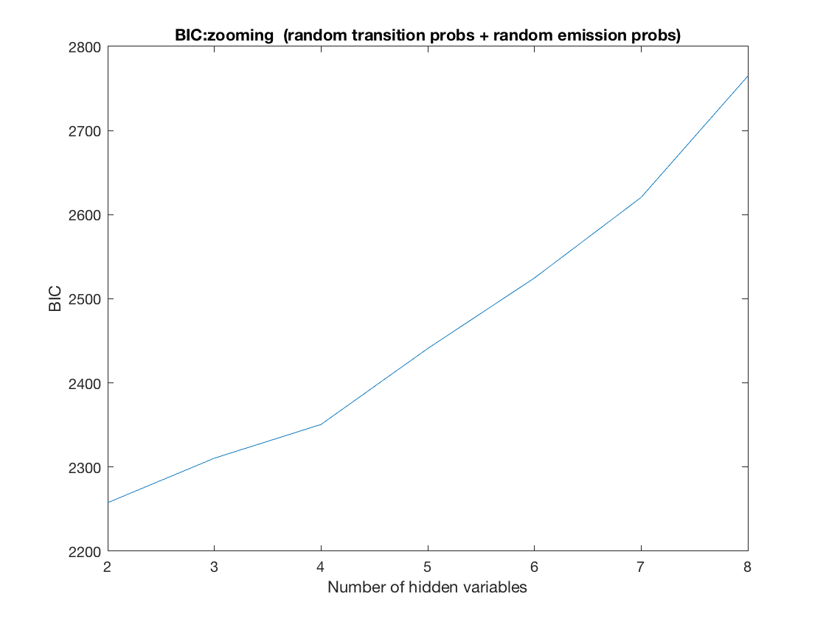
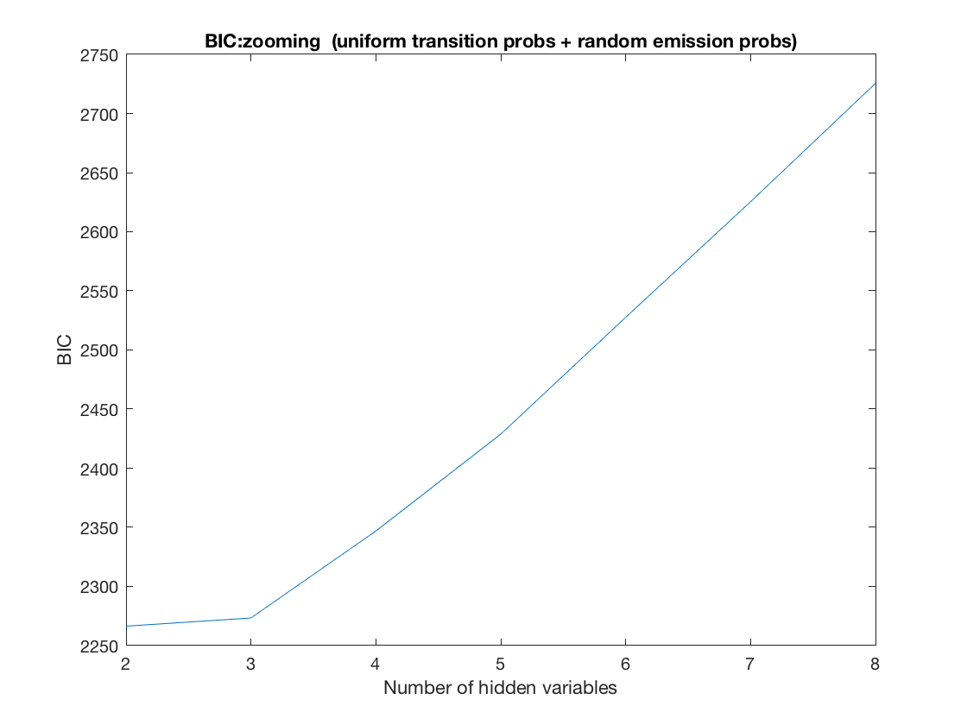
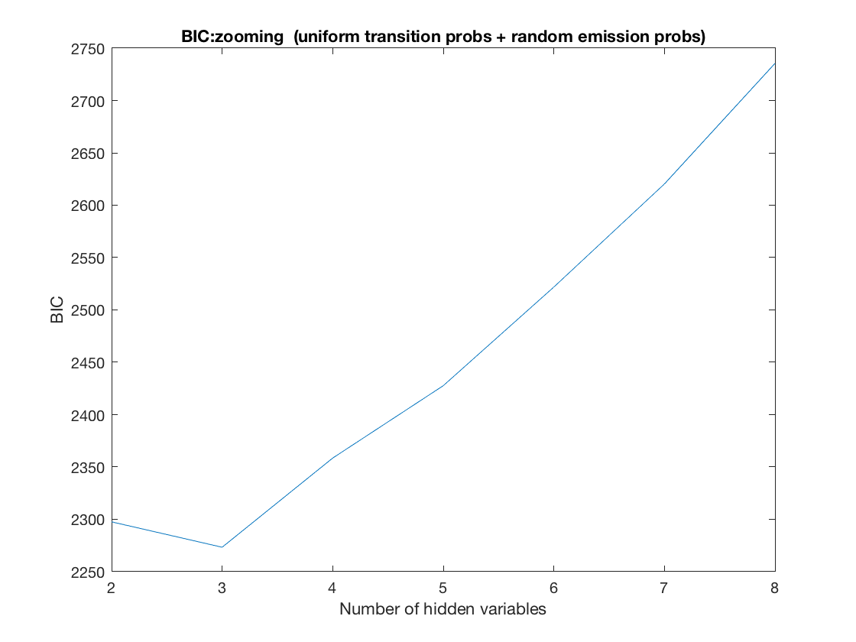
BIC Curves for Zooming Manual Part in both Supervisory and Manual+Supervisory Mode

Slide 9
index | Observations
1 | Rise
2 | Descent
3 | Move Forward
4 | Move Backward
5 | Move Left
6 | Move Right
7 | Rotate Left
8 | Rotate Right
Zooming Manual Part in both Supervisory and Manual+Supervisory Mode (2 Hidden States)
#1
52.76%
#2
88.16%
47.24%
11.84%

Slide 10
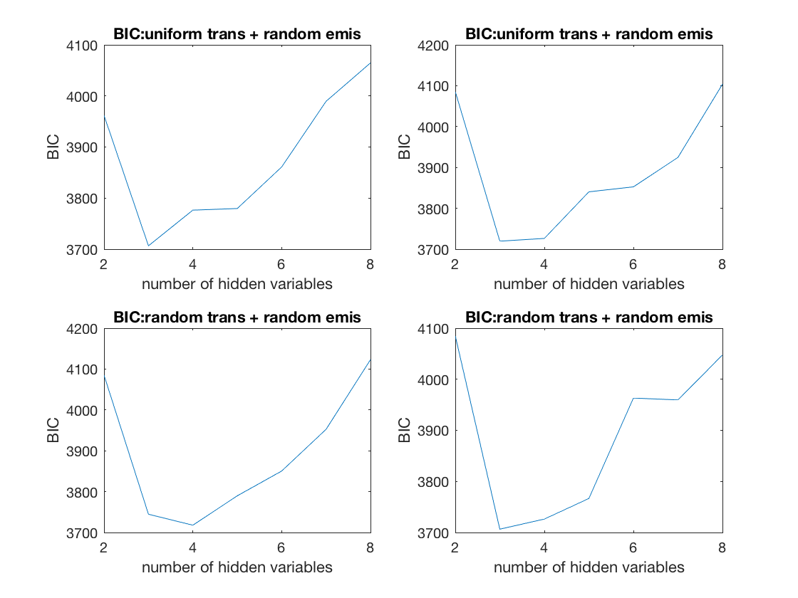
Manual BIC Curves

Slide 11
index | Observations
1 | Rise
2 | Descent
3 | Move Forward
4 | Move Backward
5 | Move Left
6 | Move Right
7 | Rotate Left
8 | Rotate Right
Manual Model (3 Hidden States)
78.70%
#1(583)
5.07%
16.23%
41.84%
8.35%
#3(246)
#2(252)
58.16%
81.66 %
9.99%

Slide 12
index | Observations
1 | Rise
2 | Descent
3 | Move Forward
4 | Move Backward
5 | Move Left
6 | Move Right
7 | Rotate Left
8 | Rotate Right
Zooming Manual Part in both Supervisory and Manual+Supervisory Mode (2 Hidden States)
15.05%
#1(188)
33.51%
51.43%
56.76%
37.78%
#3(195)
#2(212)
34.56%
54.96 %
8.68%
7.26%

Slide 13
index | Observations
1 | Rise
2 | Descent
3 | Move Forward
4 | Move Backward
5 | Move Left
6 | Move Right
7 | Rotate Left
8 | Rotate Right
Manual Model(2 Hidden States)
#1(558)
18.91%
#2(523)
18.63%
81.09%
81.37%

Slide 14
index | Observations
1 | Rise
2 | Descent
3 | Move Forward
4 | Move Backward
5 | Move Left
6 | Move Right
7 | Rotate Left
8 | Rotate Right
Zooming Manual Part in both Supervisory and Manual+Supervisory Mode (2 Hidden States)
#1(373)
52.75%
#2(222)
88.16%
47.25%
11.84%

Slide 15
index | Observations
1 | Rise
2 | Descent
3 | Move Forward
4 | Move Backward
5 | Move Left
6 | Move Right
7 | Rotate Left
8 | Rotate Right
Zooming Manual Part in Supervisory Mode (2 Hidden States)
#1(229)
56.35%
#2(157)
87.86%
43.67%
12.14%

Slide 16
index | Observations
1 | Rise
2 | Descent
3 | Move Forward
4 | Move Backward
5 | Move Left
6 | Move Right
7 | Rotate Left
8 | Rotate Right
Zooming Manual Part in Manual+Supervisory Mode (2 Hidden States)
#1(127)
53.20%
#2(82)
85.20%
46.80%
14.80%

